Slide 1
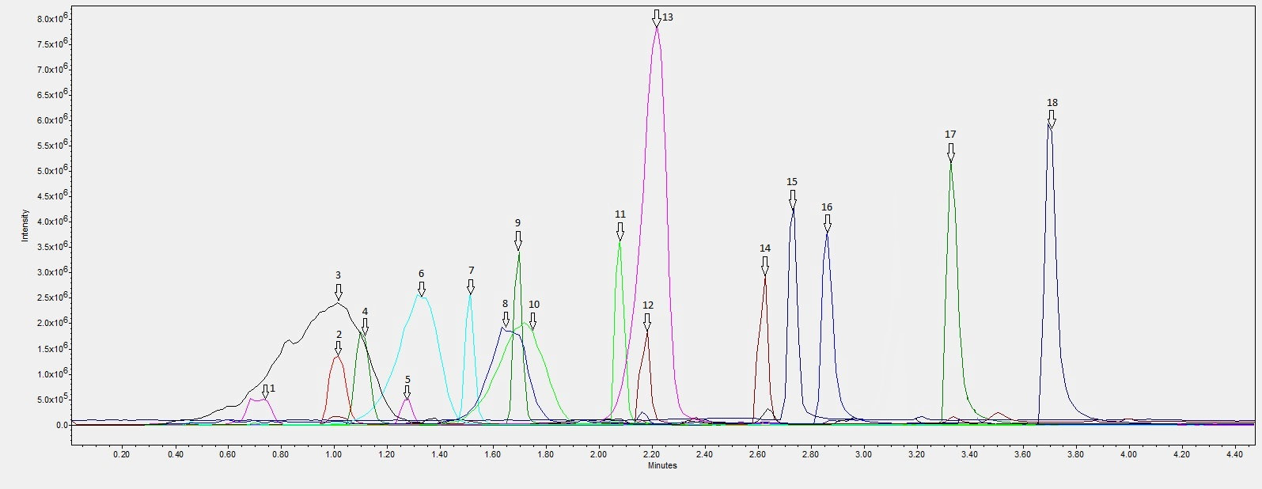
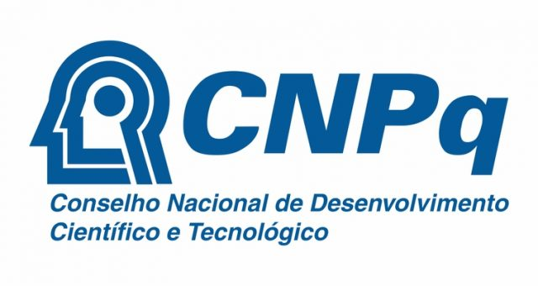
IX
ENCONTRO
PPGCF
UFRGS
Development of an analytical method for the quantification of bioactive phenolic compounds in grapes and juices Canedo-Reis, N.A.P.^{1,*}; Silva, L.F.²; Guerra, C.C.²; Bergold, A.M.¹ 1Laboratório de Química Farmacêutica, Faculdade de Farmácia, UFRGS; 2 Laboratório de Cromatografia e Espectrometria de Massas (LACEM), Empresa Brasileira de Pesquisa Agropecuária (EMBRAPA) Uva e Vinho.
INTRODUCTION AND OBJECTIVE
RESULTS AND DISCUSSION
Phenolic compounds, largely present in grapes, have demonstrated a high antioxidant capacity, which is intimately linked to their nutraceutical value. Connected to that idea, integral (full) grape juice is occupying higher levels of relevance when the issue is health. Between the years of 2010 and 2015, Rio Grande do Sul’s grape juice commercialization has improved significantly (UVIBRA, 2015). Literature research shows that there isn’t a unique method that quantifies the most important phenolic compounds in those matrices. Therefore, the aim of this project is to develop and validate a single quantification UPLC-MS method with that purpose.
The obtained method is described as follows. Mobile Phase A consisting of formic acid and water (2:98, v/v) and mobile phase B consisting of methanol, formic acid and water (90:2:8, v/v/v). The flow rate is 0,450 mL/min. The linear gradient is: from 15 to 40% of B in 1,35 min; from 40 to 65% of B in 1,30 min; from 65 to 90% of B in 0,90 min; 90% of B for 0,35 min; from 90 to 30% of B in 0,35 min; from 30 to 15% of B in 0,25 min; 15% of B for 3 min to equilibrate the column for next injection. The total time of analysis is 7,50 min. The retention time obtained for the tested compounds is shown in Figure 1.
Figure 1: Overlaid chromatograms showing the retention time obtained for each of the compounds.
1) Procyanidin B1 – 0,70 min; 2) Epigallocatechin – 1,01 min; 3) Delphinidin-3,5-diglucoside – 1,02 min; 4) Catechin – 1,10 min; 5) Procyanidin B2 – 1,27 min; 6) Cyanidin-3,5-diglucoside – 1,33 min; 7) Epigallocatechin Gallate – 1,51 min; 8) Peonidin-3,5-diglucoside – 1,63 min; 9) Epicatechin – 1,69 min; 10) Malvidin-3,5-diglucoside – 1,71 min; 11) Epicatechin Gallate – 2,08 min; 12) Taxifolin – 2,17 min; 13) Malvidin-3-O-glucoside – 2,21 min; 14) Rutin – 2,62 min; 15) Resveratrol – 2,73 min; 16) Miricetin – 2,86 min; 17) Quercetin - 3,33 min; 18) Kaempferol – 3,70 min.
CONCLUSIONS
REFERENCES
Compounds with the same mass (or too similar masses) were completely separated: Epicatechin (289,08 Da) and Catechin (289,08 Da); Procyanidin B1 (577,14 Da) and Procyanidin B2 (577,14 Da); Rutin (609,15 Da) and Cyanidin-3,5-diglucoside (611,16 Da). The validation of the UPLC-MS method is been executed at the present moment. The validated method will be applied in the quantification of phenolic compounds in grapes and in its corresponding juices.
UVIBRA. União Brasileira de Vitivinicultura. Comercialização de vinhos e derivados elaborados no RS de 2010 a 2015 – mercado interno e externo. Bento Gonçalves, 2015. Disponível em <http://www.uvibra.com.br/pdf/comercializacao2010a2015_jul.pdf>. Acesso em 16/10/2017.
ACKNOWLEDGEMENTS

